Slide 1
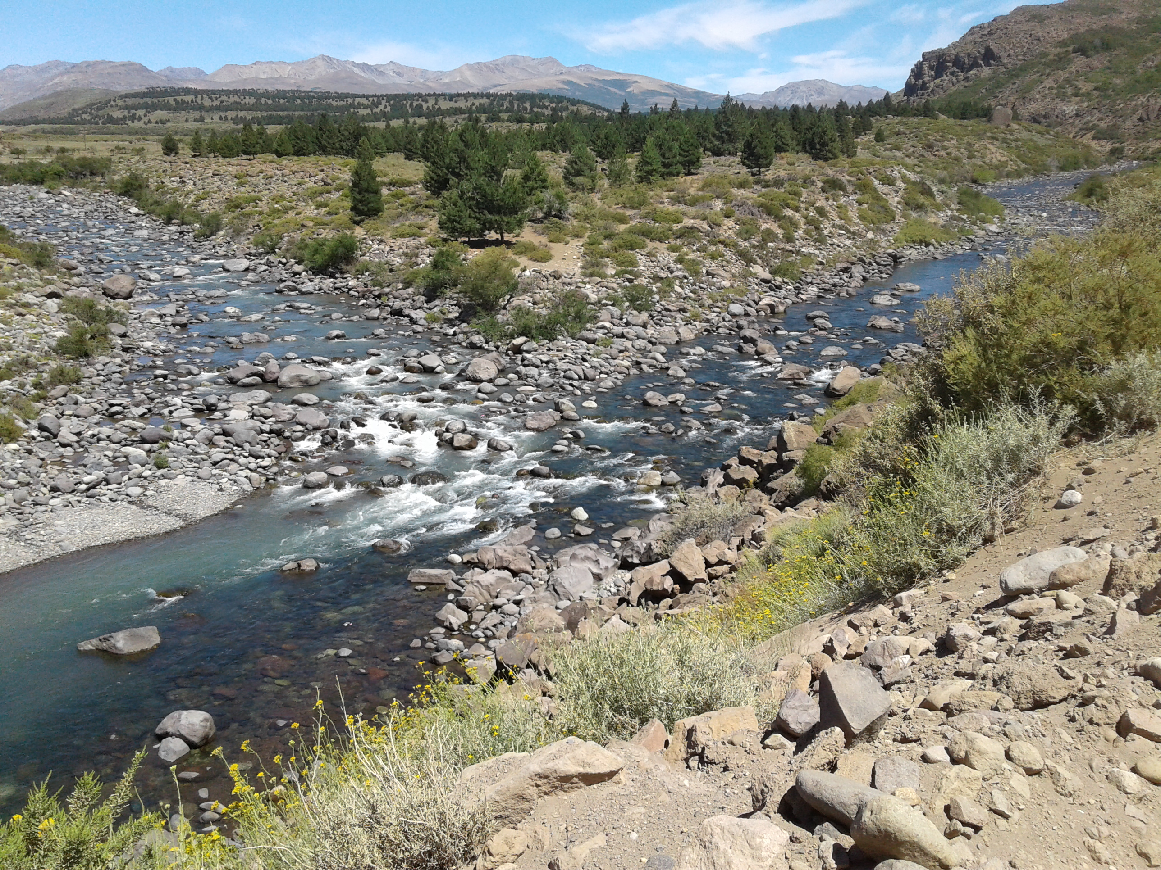
TOWARD
POST-EXTRACTIVISM
DEVELOPMENT ALTERNATIVES
Prepared by Sister Anamaria Siufi, RSM, of Argentina, September 2024

Slide 2

CONCENTRATED GROUPS OF POWER
MANAGE THE WORLD MORE AND MORE
Investment firms and banks
Exxtractive industries
Weapons corporations
Organized crime (trafficking in drugs, arms, persons and organs)

Slide 3
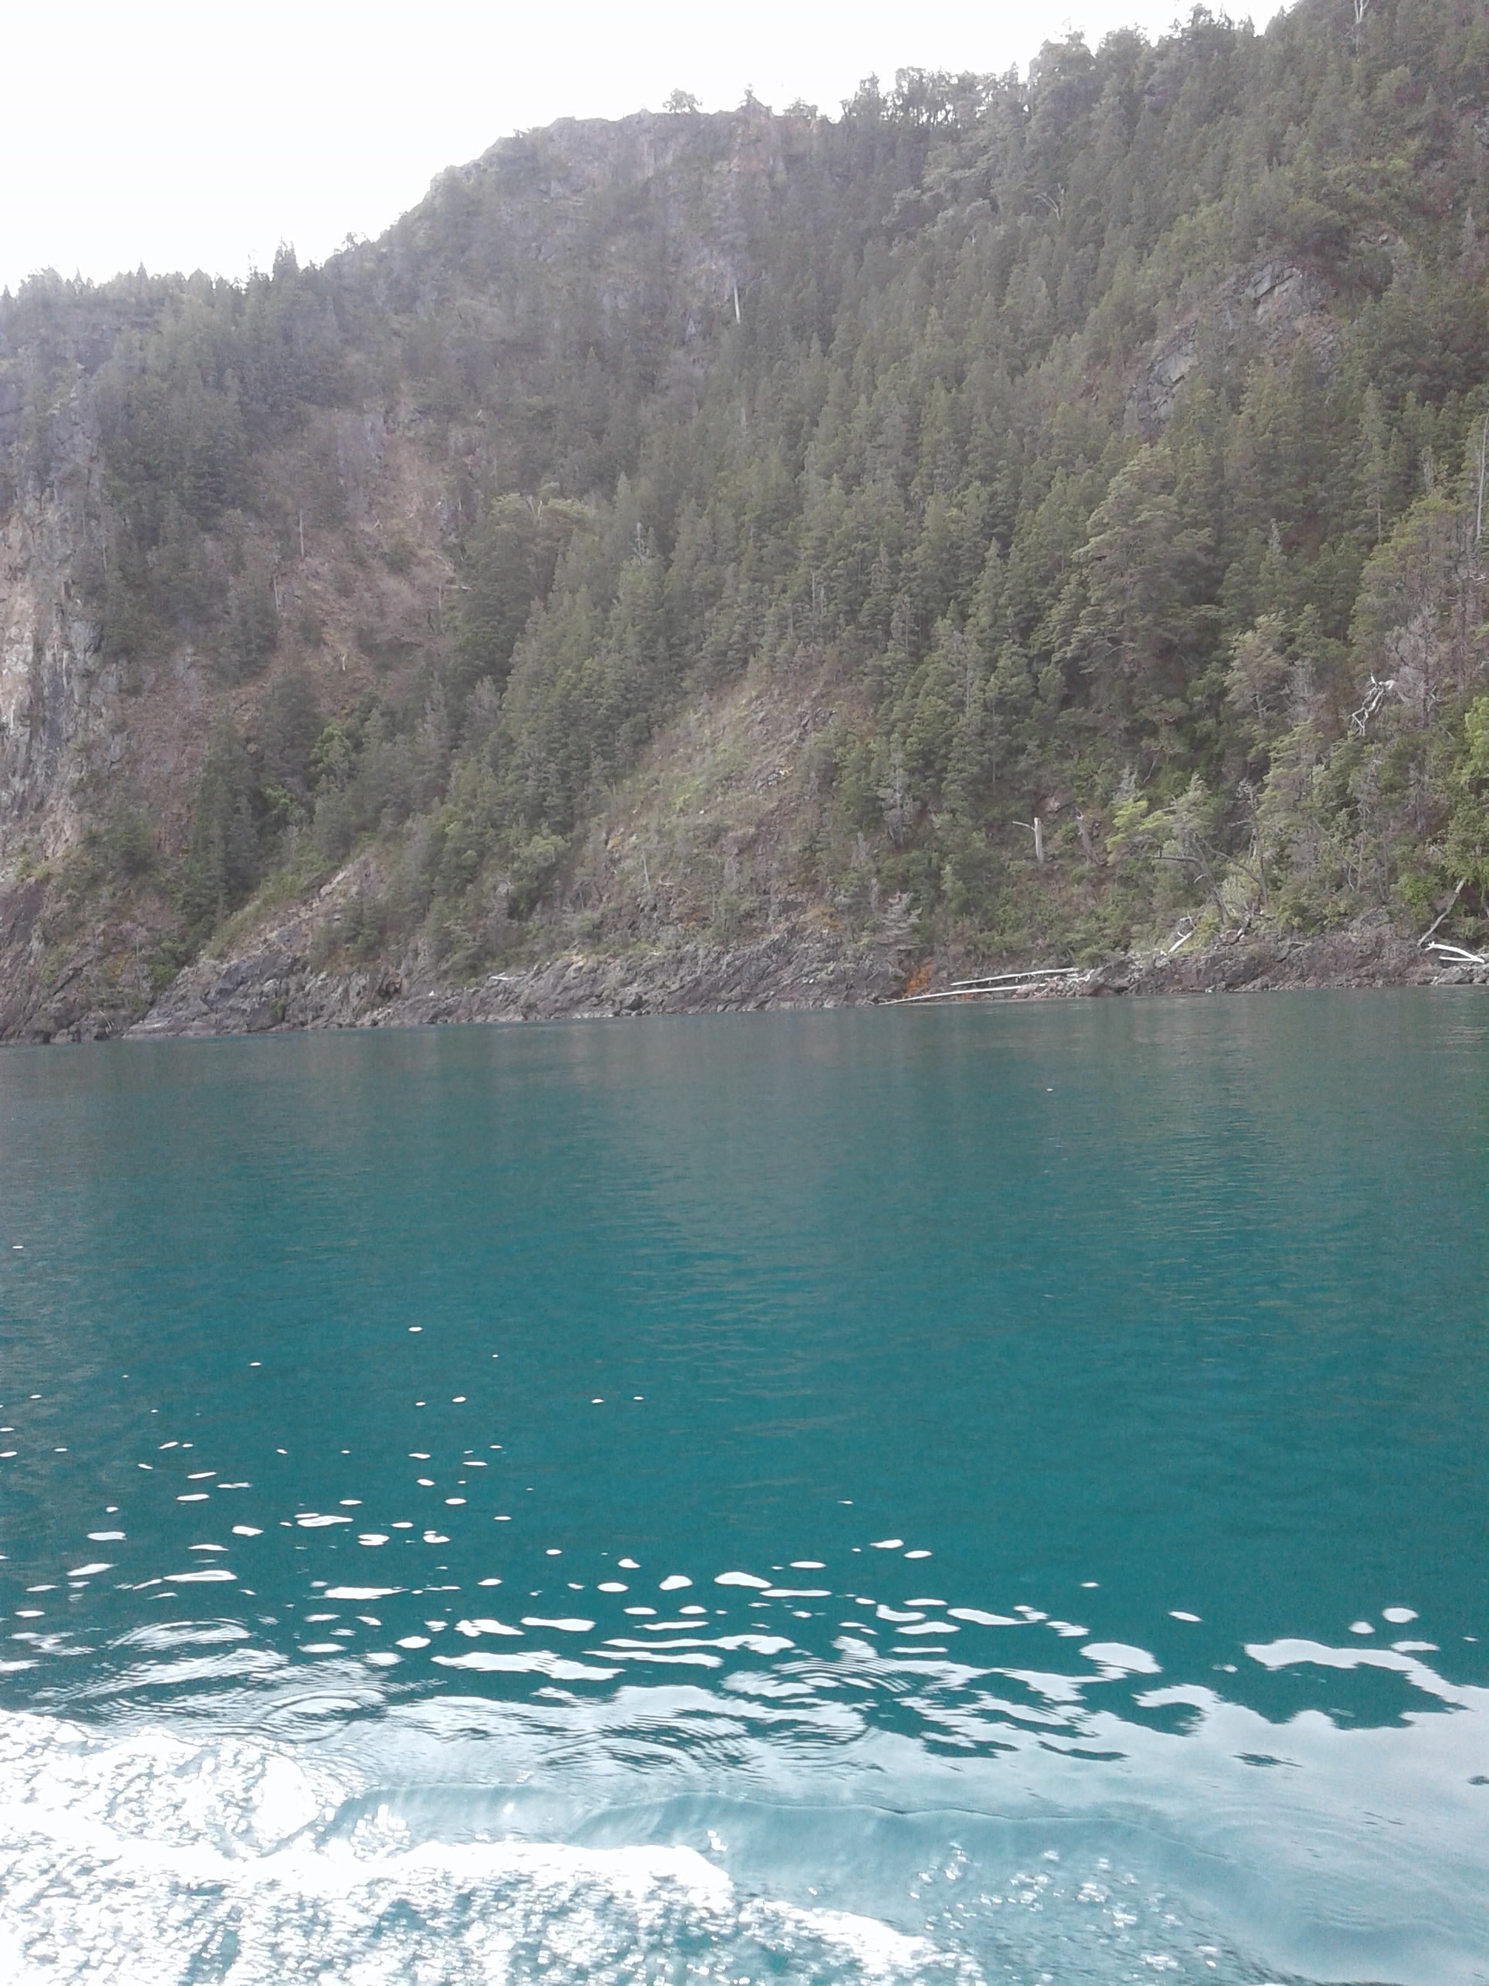
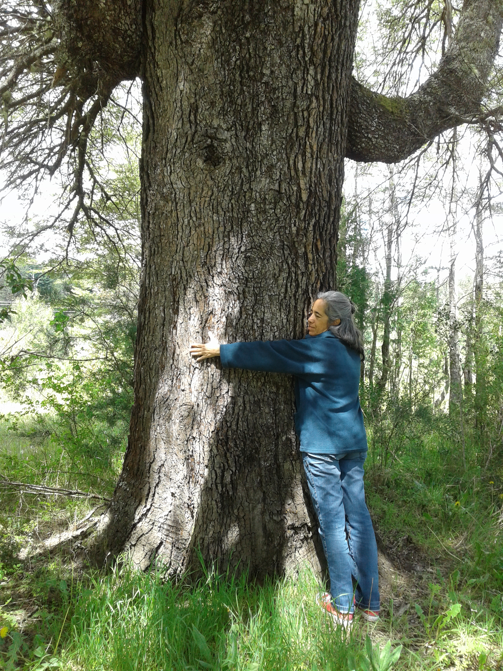
«EXTRACTIVISM IS THE CENTRAL PART
OF AN ECONOMIC SYSTEM THAT CONVERTS THE NATURAL ASSETS INTO CAPITAL/MERCHANDISE»
Pastoral Letter of the Latin American Episcopal Council (CELAM) 2018
I

Slide 4
EXTRACTIVISM
«SEEKS TO EXTRACT THE MOST AMOUNT OF MATERIALS IN THE SHORTEST AMOUNT OF TIME, TO CONVERT THEM INTO COMMODITIES (RAW MATERIALS) FOR THE INDUSTRY
WHICH WILL TRANSFORM THEM INTO PRODUCTS
AND SERVICES FOR THE MARKET, WHERE SOCIAL SECTORS WILL CONSUME THEM AND THEN RETURN THEM TO NATURE AS CONTAMINATING WASTE. »
Pastoral Letter of the Latin American Episcopal Council (CELAM) 2018

Slide 5
THE GREAT TRIUMPH OF NEOLIBERALISM WAS TO MAKE US BELIEVE THAT THERE ARE NOT MORE ALTERNATIVES.
Naomi Klein

Slide 6
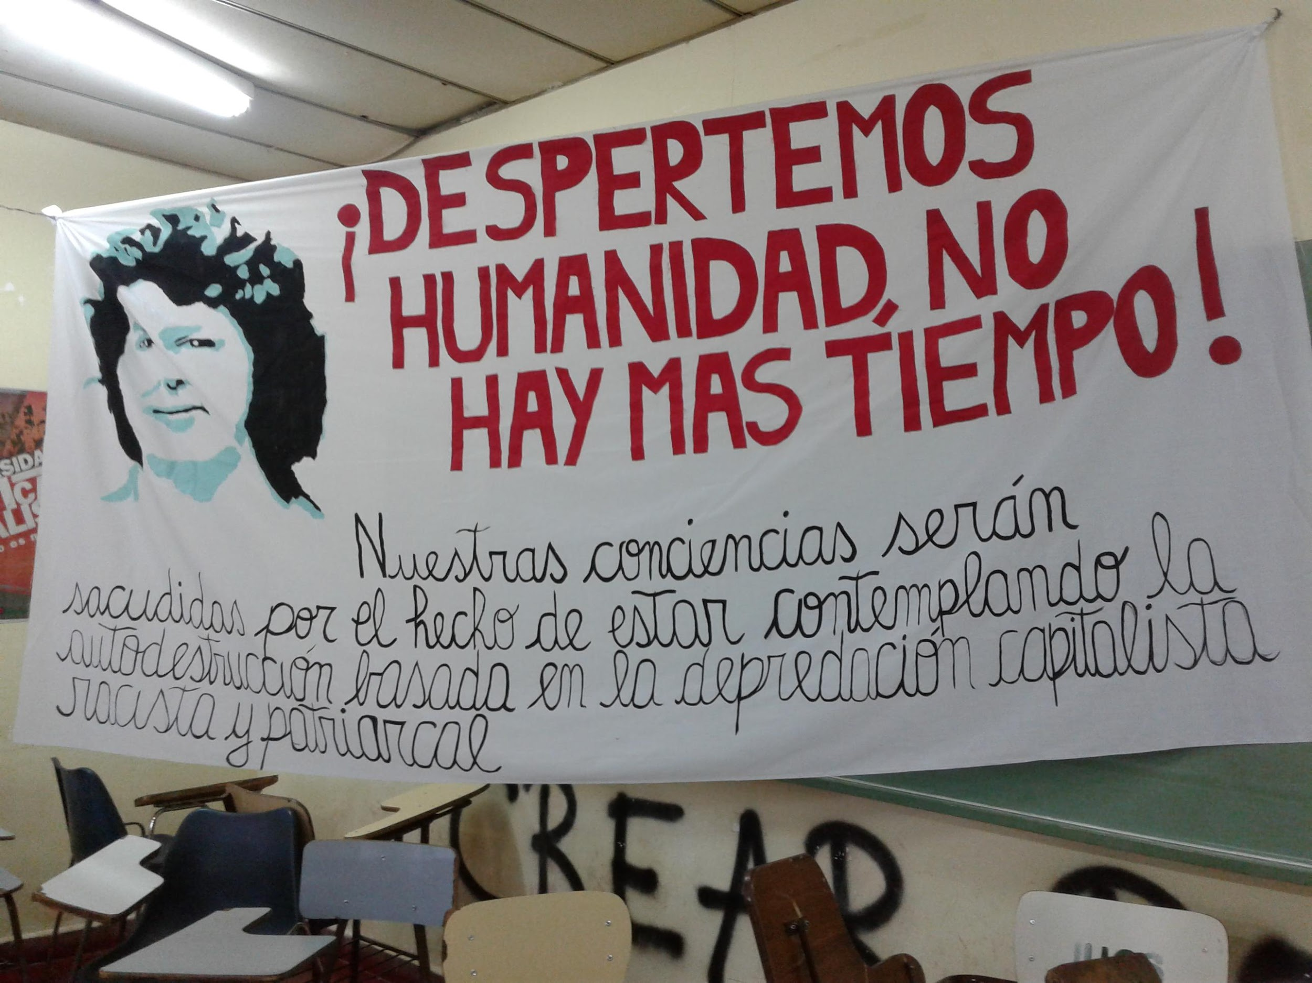
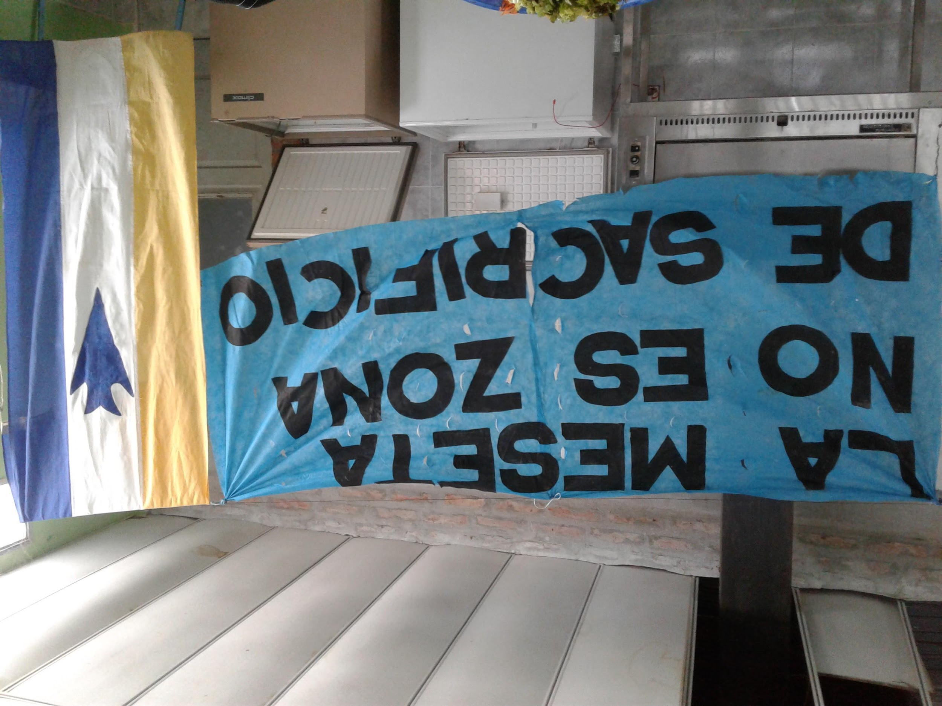
THE SEARCH FOR ECONOMIC ALTERNATIVES ARE DISQUALIFIED AS NAIVE, DANGEROUS, RETROGRADE OR IMPOSSIBLE
.

Slide 7
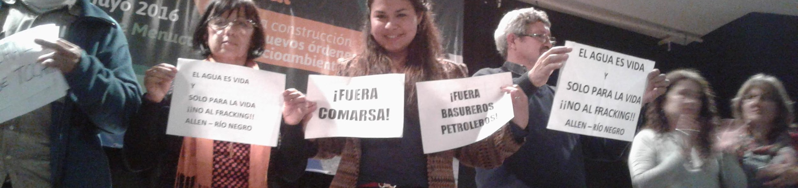
MEGA-MINING ACTIVITIES, FOSSIL FUELS, HYDROELECTRICS, FISHERIES, FORESTS, ROAD WORKS OR TOURIST INFRASTRUCTURES ARE PREDATORY EXTRACTIVISM AND UNLEASH GROWING CONFLICTS ALL OVER THE WORLD.
THE SO-CALLED GREEN ECONOMY TRIES TO CHEAT US WITH FALSE SOLUTIONS: CHANGE EVERYTHING SO THAT NOTHING CHANGES. WE MUST BE ALERT!

Slide 8
PREDATORY EXTRACTIVISM:
It is at the service of the global market, for the overconsumption of the few, without any limits nor effective controls.
Tax on communities and impoverishing them.
Exploiter of the land and the workers.
Looter of territories, with zones and people that can be sacrificed.
Destroyer of cultures and local production.
Eliminates food sovereignty.
Criminalizes, persecutes and kills the defenders of the earth and steps on the rights of the communities.
Cause of climate change, ecocidal, unsustainable

Slide 9
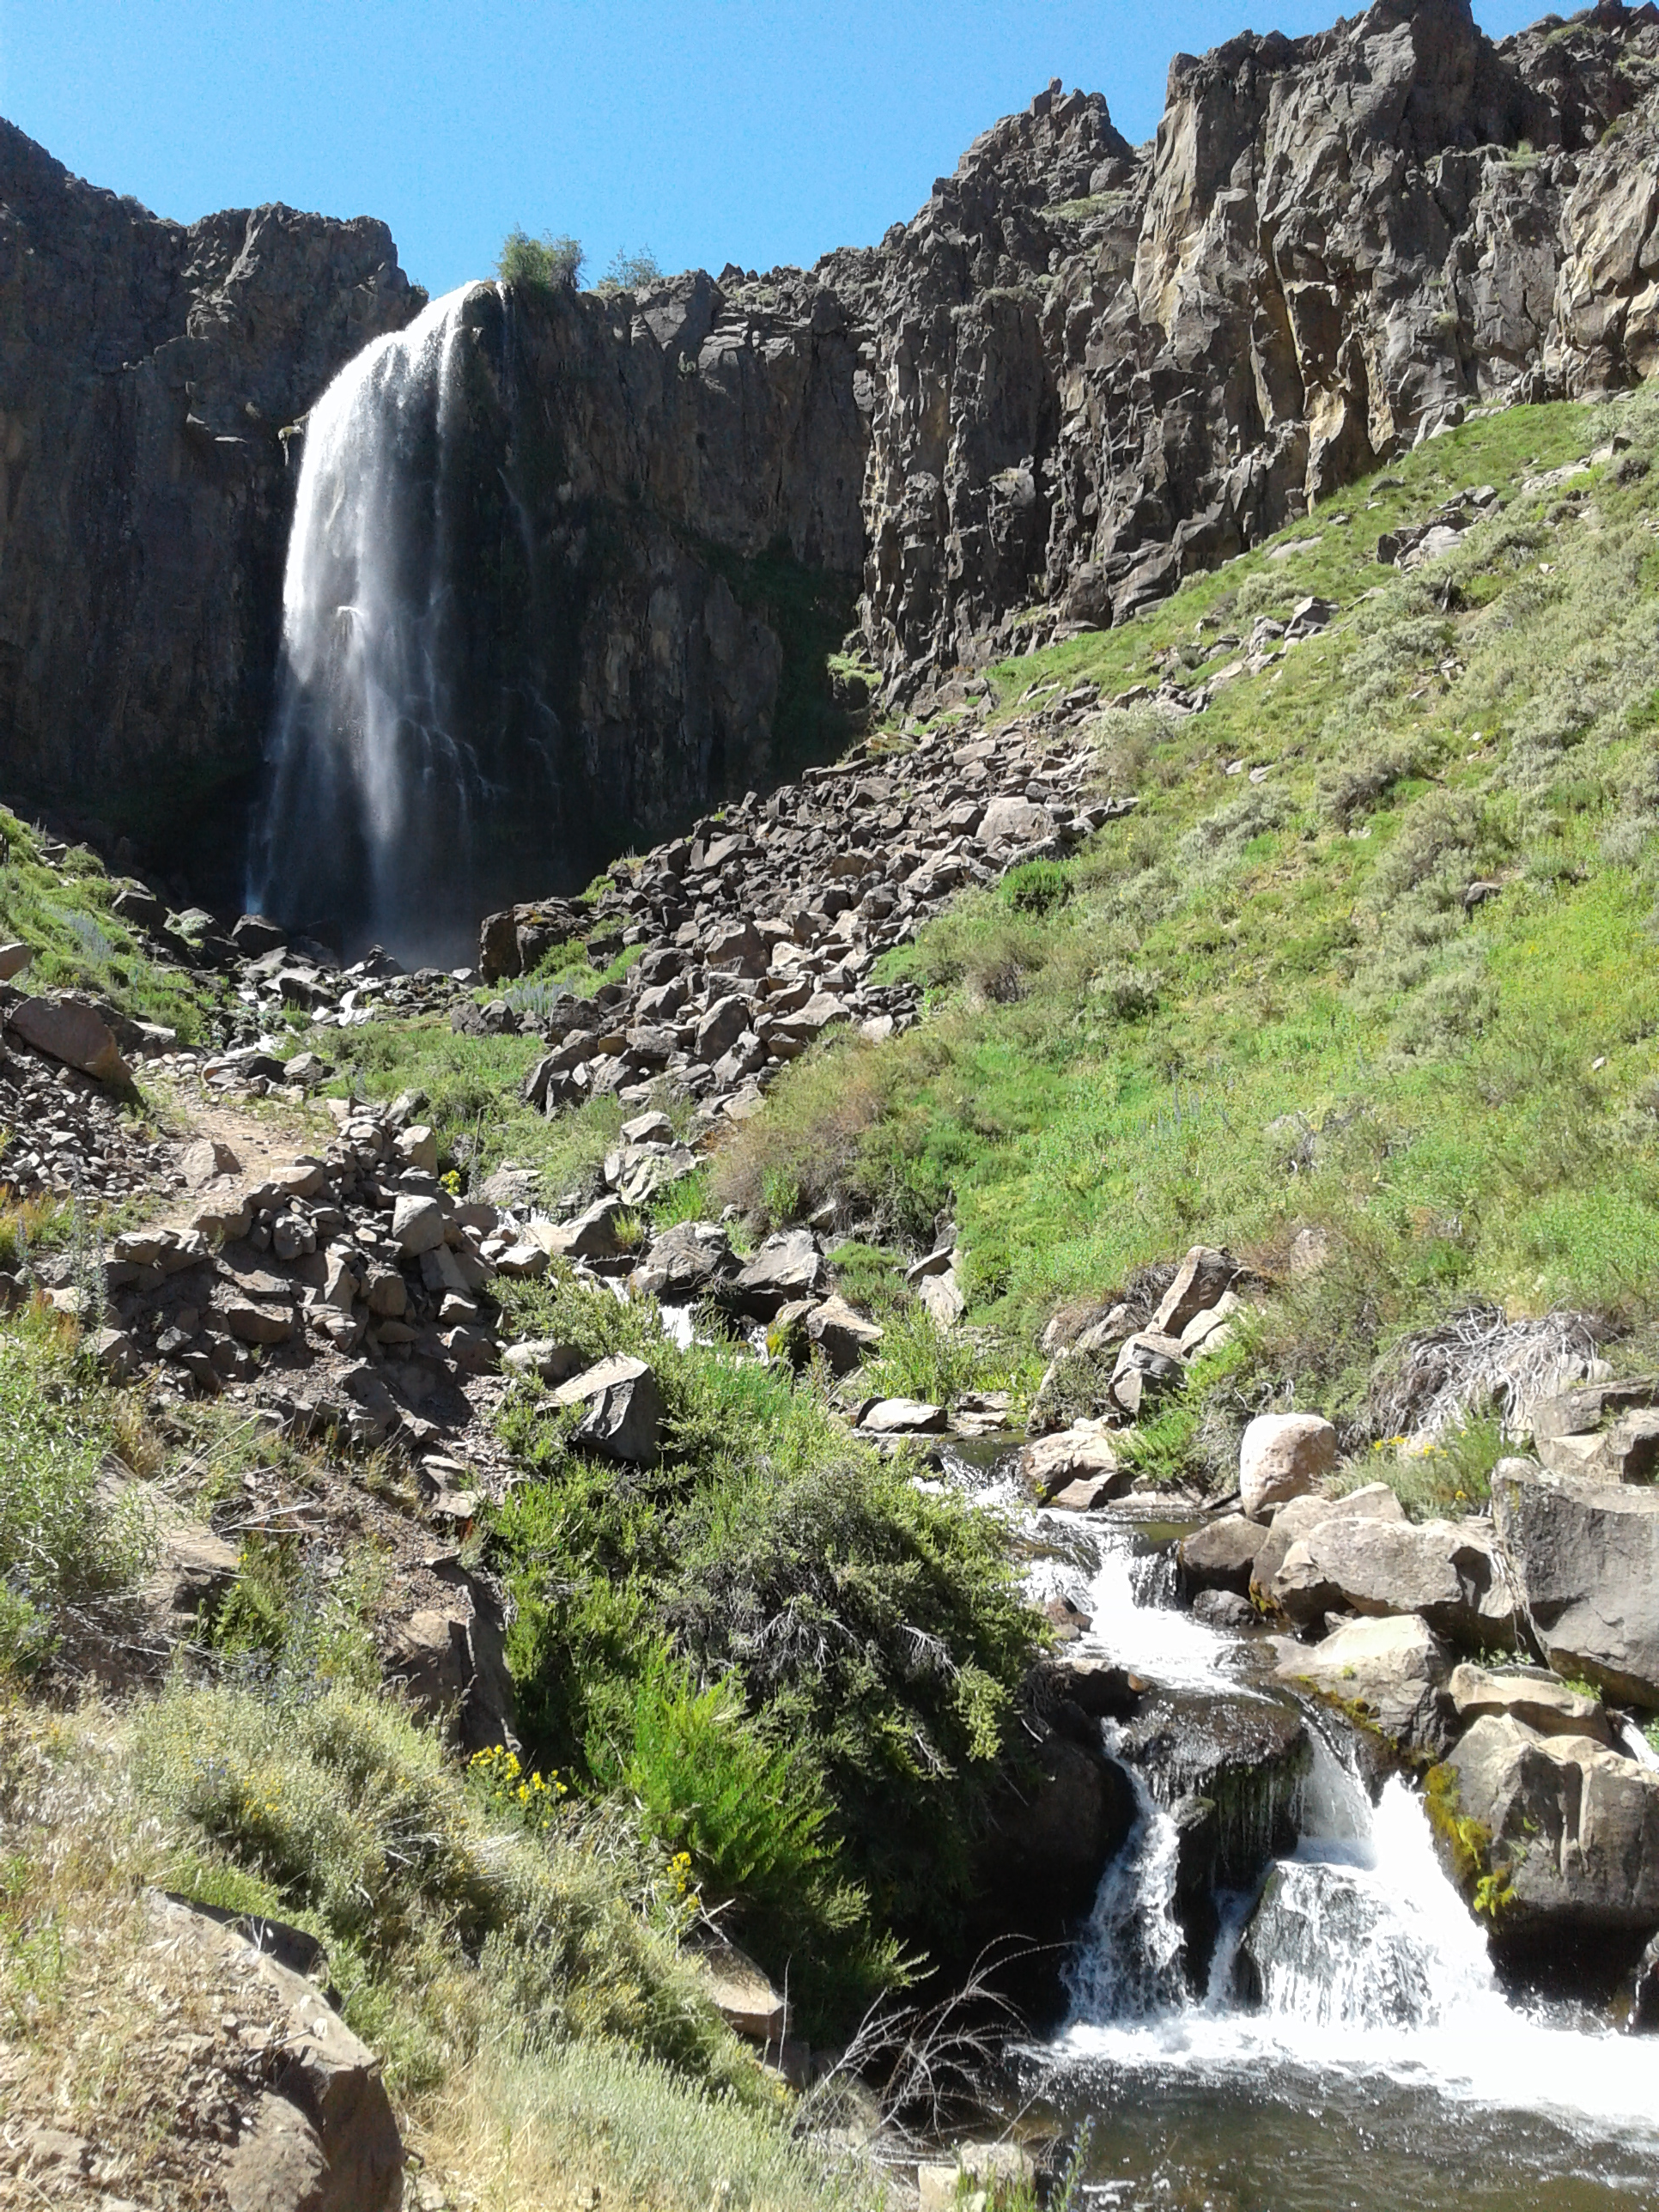
TODAY'S EXTRACTIVISM IS LEADING US TO PLANETARY COLLAPSE. WE NEED A SENSIBLE EXTRACTIVISM, OF TRANSITION, TO REACH INDISPENSABLE EXTRACTIVISM OR MINIMAL AND SUSTAINABLE EXTRACTIVISM.

Slide 10
A SENSIBLE, TRANSITIONAL EXTRACTIVISM IS URGENT
IN WHICH SOCIAL AND ENVIRONMENTAL NORMS ARE FULFILLED THROUGH ALL THE PRODUCTIOM PROCESS, WITH EFFECTIVE AND RIGOROUS CONTROLS.
GLOBAL EXPORTING ORIENTATION IS REDUCED BECAUSE
IT MEETS LOCAL OR REGIONAL NEEDS AND NOT FOR THE PROFIT
AND CONSUMERISM OF A FEW PEOPLE.

Slide 11
INDISPENSABLE OR MINIMAL EXTRATIVISM
IS VERY LIMITED AND RELATED TO NATIONAL OR REGIONAL ECONOMIC CHAINS. GLOBAL EXPORT ORIENTATION IS REDUCED.
PRODUCTION PROCESS WITH LOWER USE OF ENERGY AND MATTER.
THIS EXTRACTIVISM WILL PROMOTE LIMITED CONSUMPTION THROUGH THE USE OF RECYCLING AND PROLONGED USE OF THE OBJECTS.
IT WILL NOT SEEK ECONOMIC GROWTH BUT QUALITY OF LIFE, RESPECT FOR CULTURES AND ENVIROMENTAL CONSERVATION.

Slide 12
SLAVERY, FEUDALISM, COLONIALISM,
FASCISM, APARTHEID, DICTATORSHIPS WERE LEGAL.
EXTRACTIVISM IS LEGAL.
LEGALITY IS A MATTER OF POWER
AND NOT OF JUSTICE.

Slide 13
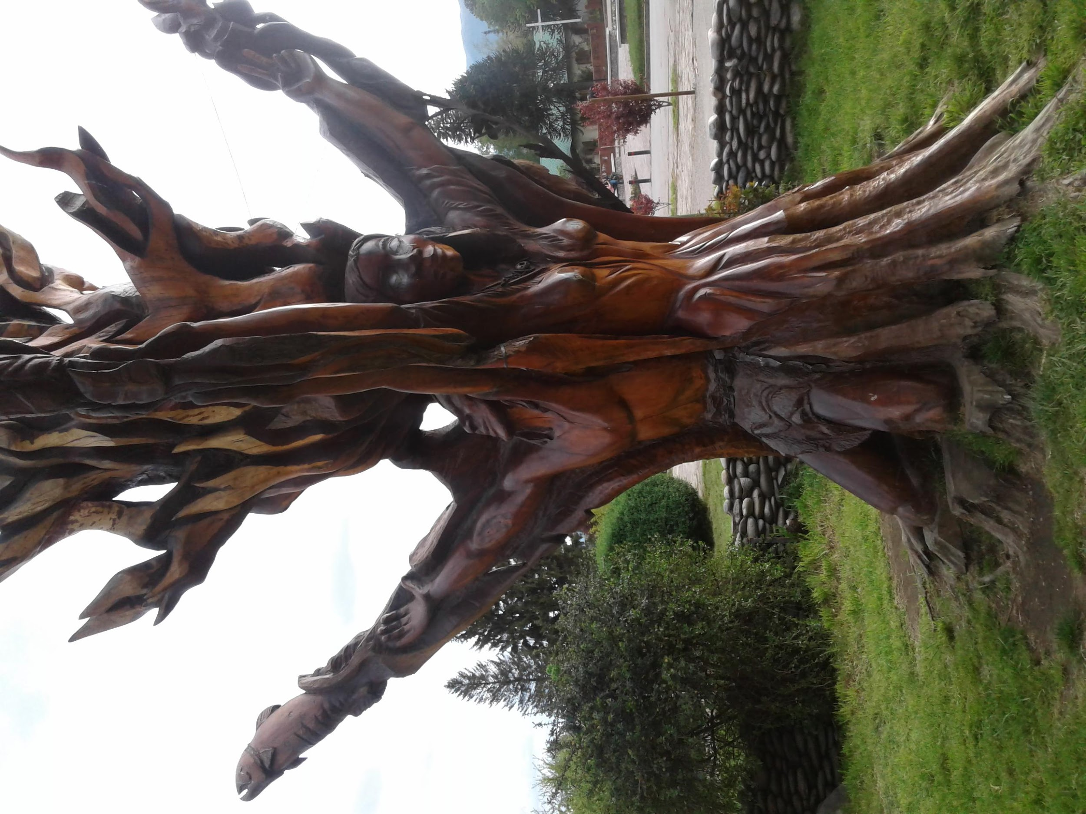
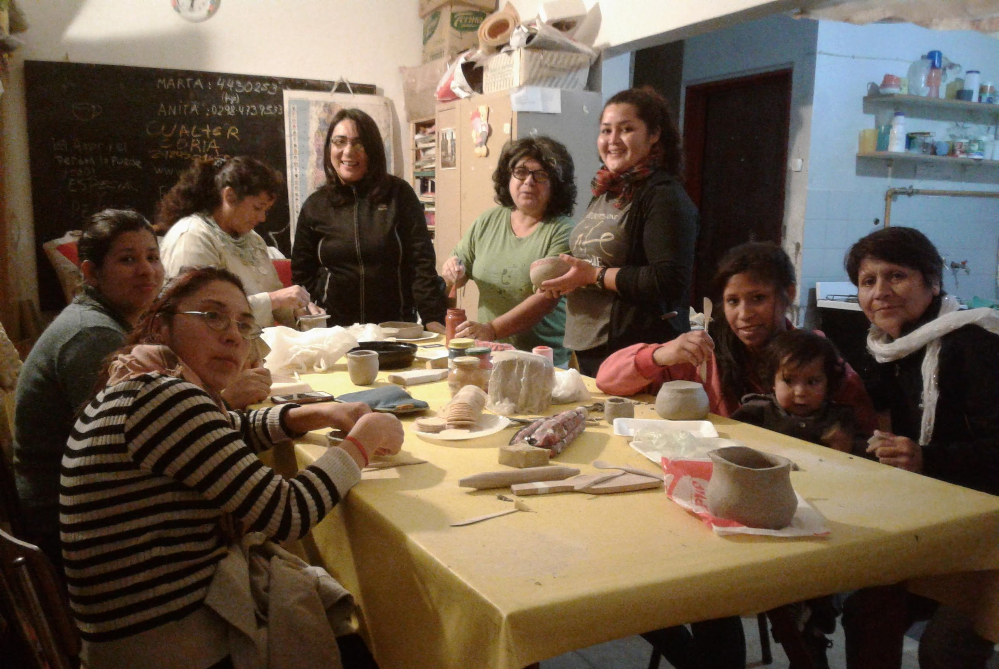
WE NEED A CULTURAL REVOLUTION TO CHANGE
THE GLOBAL DEVELOPMENT MODEL AND REDEFINE PROGRESS BY QUESTIONING THE LOGIC OF GROWTH
AND THE CURRENT PATTERN OF PRODUCTION AND CONSUMPTION. (Laudato Si’)

Slide 14
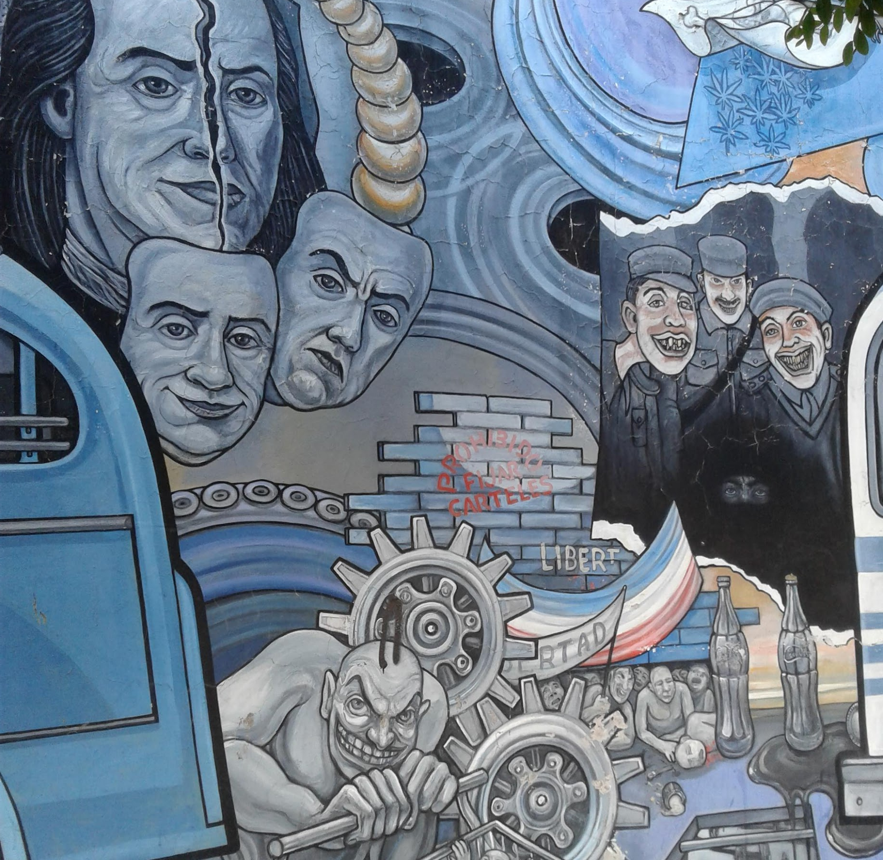
IF THERE IS NO ECONOMIC DEMOCRACY, THERE IS NO DEMOCRACY.
IT IS POSSIBLE TO HAVE A SOCIAL AND SOLIDARITY ECONOMY THAT RESPECTS THE RIGHTS OF MOTHER EARTH AND IS AT THE SERVICE OF THE COMMON GOOD AND GOOD LIVING.

Slide 15
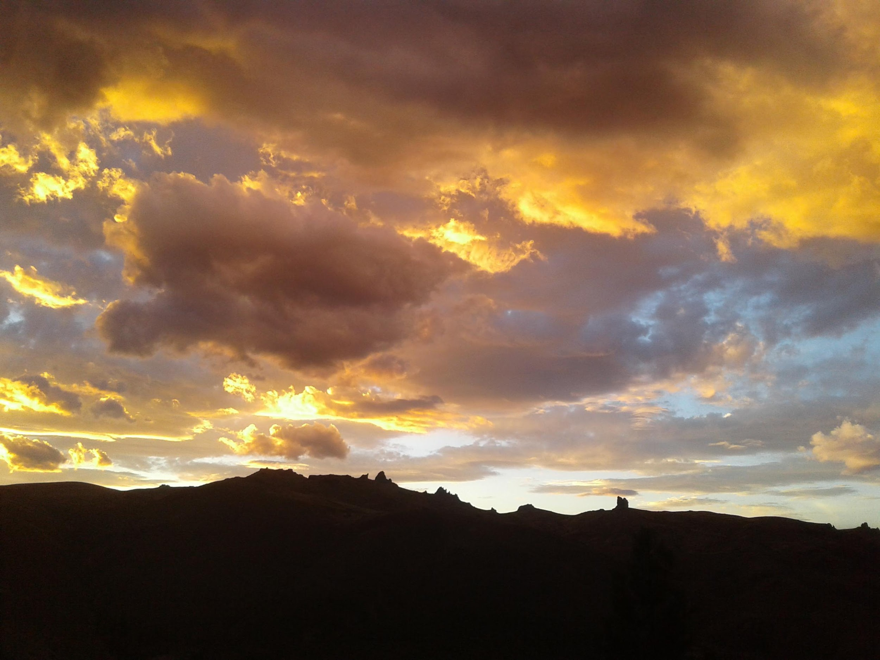
GOD, WE PRAY,
HELP US TAKE CARE OF THE WORLD AND THE QUALITY OF LIFE OF THE POOREST, THROUGH A CHANGE OF MENTALITY, CONSCIOUSNESS, HABITS AND HEART (
(Laudato Si’)

